Slide 1
Introduction to Game Design

Slide 2
Topics Covered in this session
What is Game Design
Game Design Term Definition
Role of designers in a studio

Slide 3
What is Design
Dictionary result for design /dɪˈzʌɪn/ noun noun: design; plural noun: designs 1. a plan or drawing produced to show the look and function or workings of a building, garment, or other object before it is made. 2. a decorative pattern. 3. purpose or planning that exists behind an action, fact, or object

Slide 4
What is Game Design?

Slide 5
What is Game Design then?
Game development is the process of manifesting a producer and director’s ideas into reality. The driving force behind this process, which provides detailed direction and motivation to our entire staff from artists to programmers, is our team of game designers. No matter how talented your staff is, they can’t create a truly classic game without strong direction. As a game designer, you won’t make visuals. You won’t compose music. But your ideas will shape the world of the game most directly of all. Platinum Games

Slide 6
Game designers make the conscious decisions that shape the player experience

Slide 7
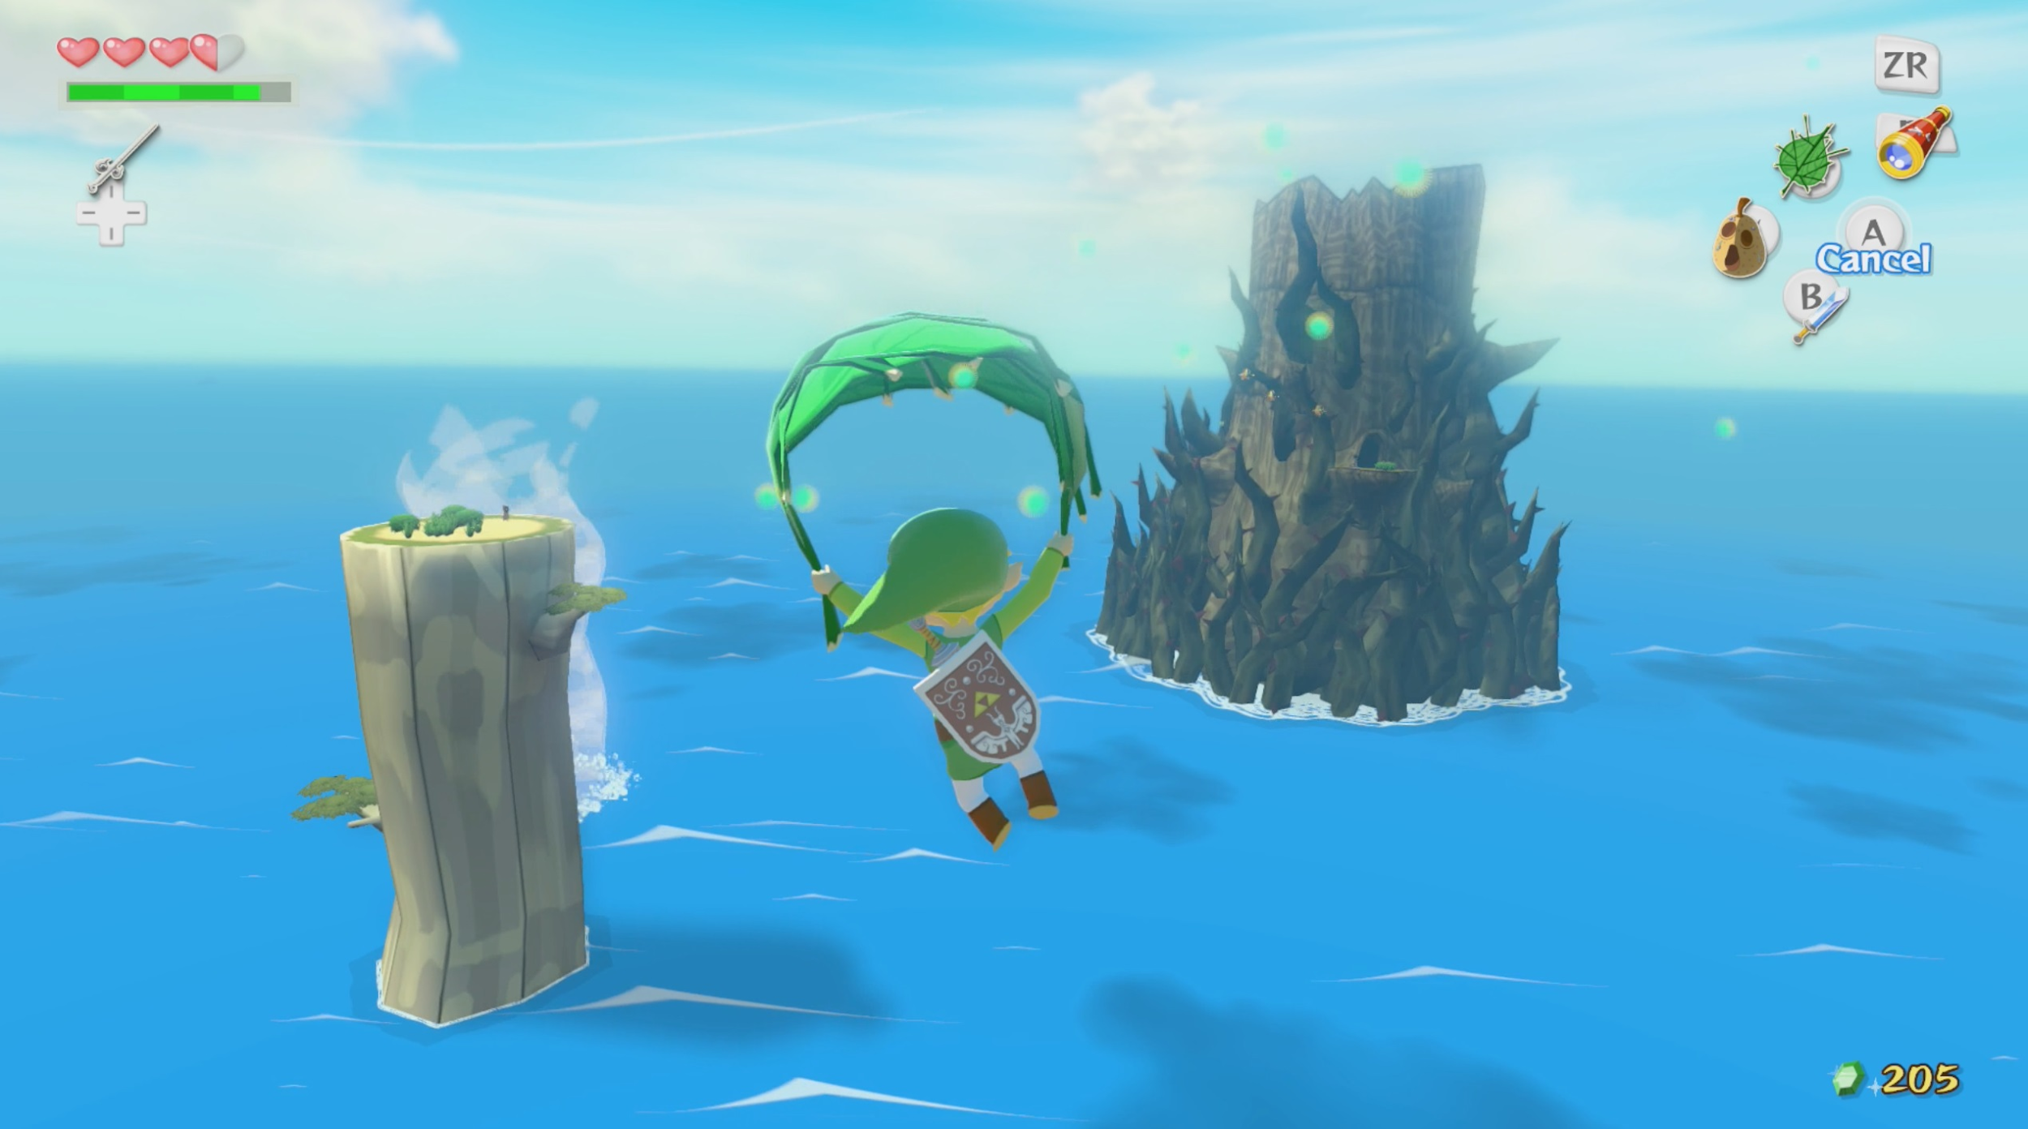

Slide 8

Is this good design ?

Slide 9
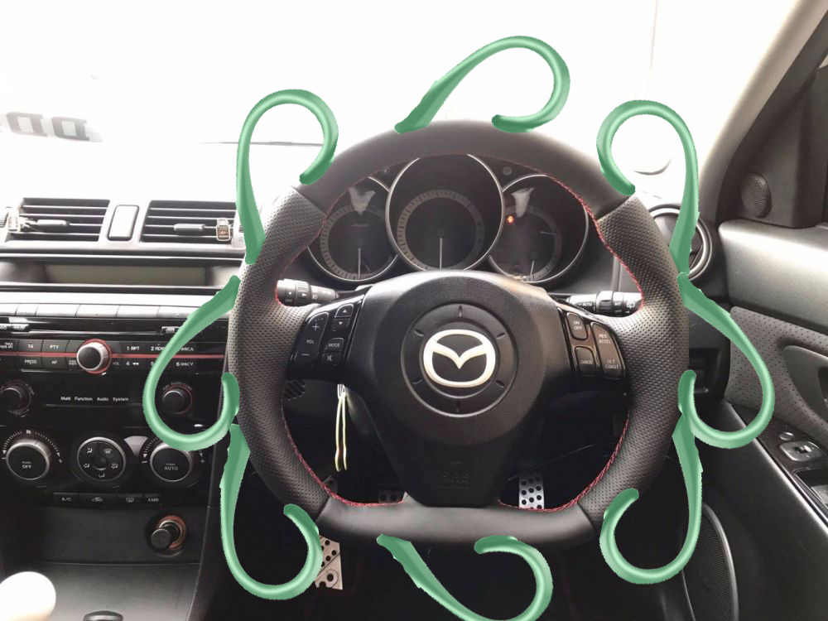
Is this good design?

Slide 10
Good game design is contextual but there are principles that can help

Slide 11
What makes a game
Tools of play
Rule development
Victory conditions
Single or multiplayer
Storyline or plot
Luck and strategy

Slide 12
Design Terminology

Slide 13
Mechanics
Also called verbs
What does the game “do”
Can be very broad (win/lose state) or specific (running, jumping etc)
Break down into sections
Primary - Game dependant
Secondary - supports primary
Tertiary - quality of life

Slide 14
Assets
Any component that makes up a game
Sprites
Models
Textures
Sounds
Programs
A lot more

Slide 15
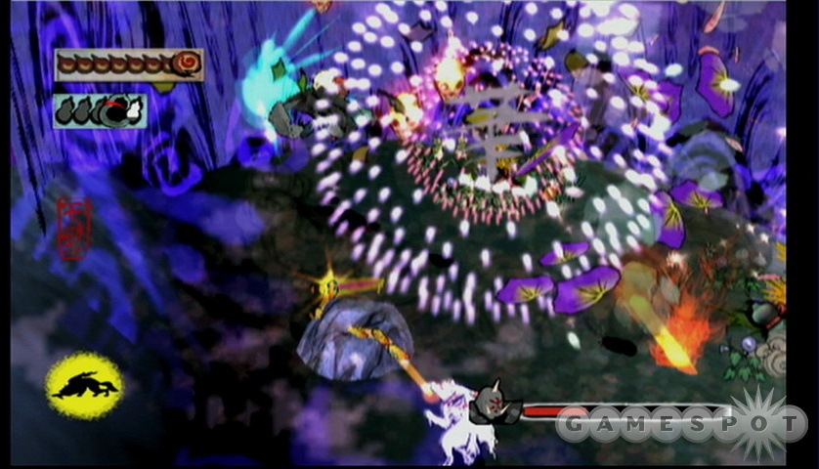
Feedback loop
Player Input - Game responds - Player input

Slide 16
Feedback Loop
Input
Output

Slide 17
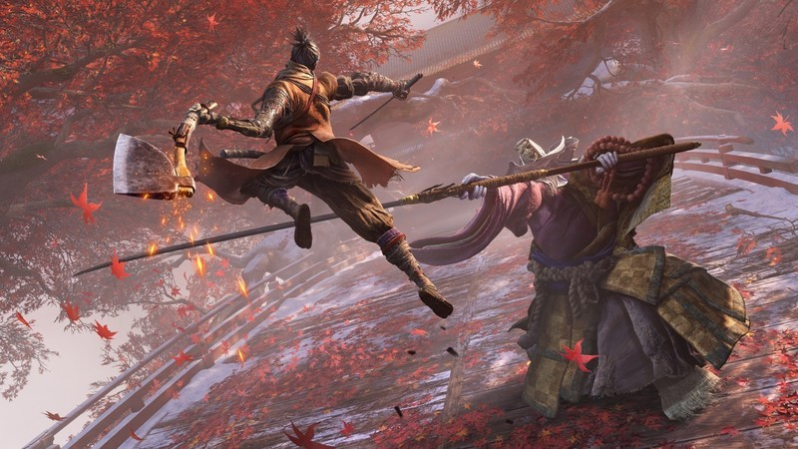
Flow
Adapt the difficulty of the game to the players skill level
Allow a “Cool off period” for the player to display their mastery

Slide 18
Flow
Difficulty
Skill

Slide 19
Flow
Frustration
Difficulty
Mastery
Boredom
Skill

Slide 20
Thesis, Antithesis, Synthesis (Goal, Conflict, Result)
What does the player want to accomplish
What stops the player from completing the goal
What happens when the player interacts with the conflict

Slide 21
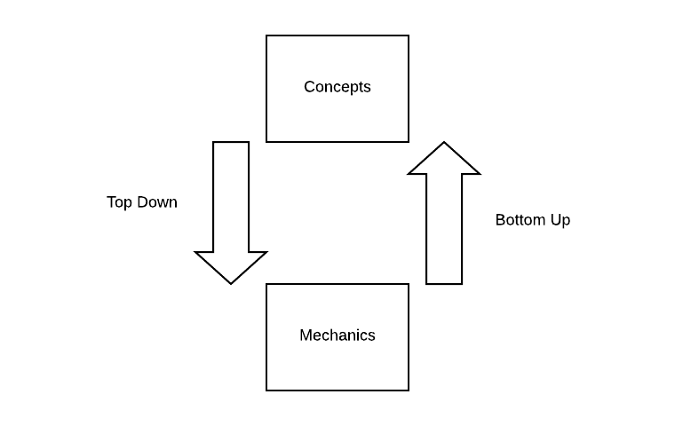
Top Down / Bottom up

Slide 22
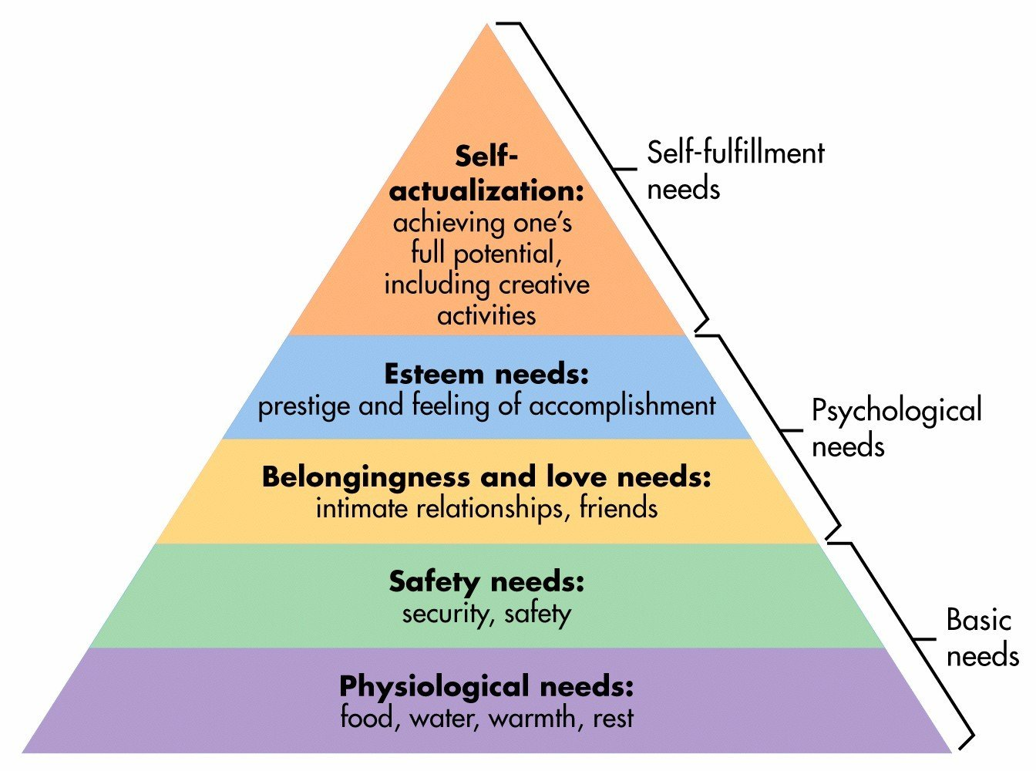
Maslow's Hierarchy of needs

Slide 23
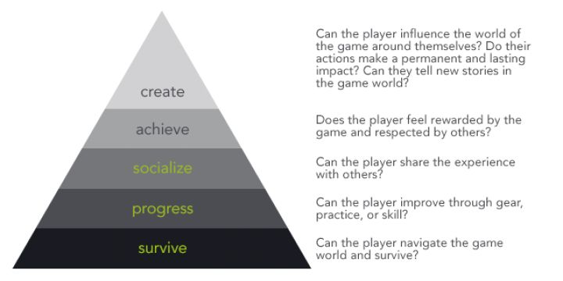

Slide 24
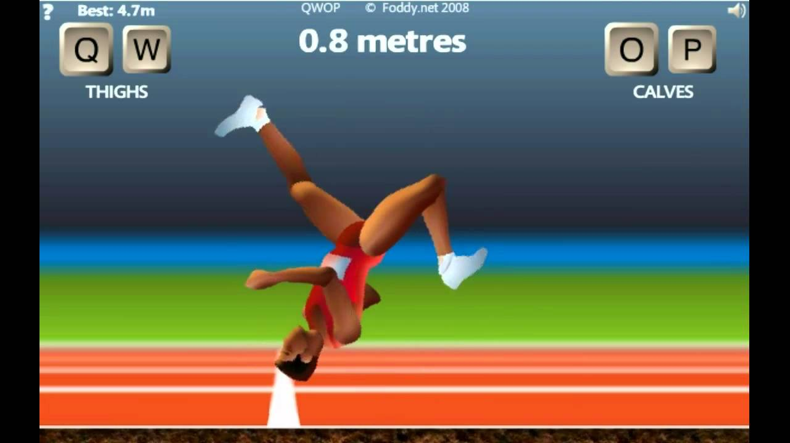
Hook
What makes the game remarkable

Slide 25
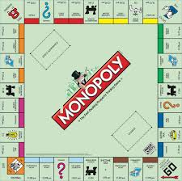
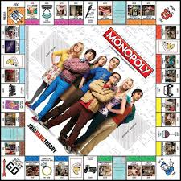
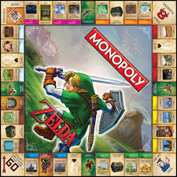
Theme

Slide 26
Mechanics
What the game can do
Assets
Things that make up the game
Feedback Loop
The relationship between the players input and the games response
Flow
The difficulty of the game adapting to the players skill
Thesis,
Antithesis, Synthathis
The goal of the player, the obstacle preventing the player, the result of the player interacting with the obstacle

Slide 27
Game Designer Job Description
Designers have various branches in studios
Level designers
Combat designers
System designers
Narrative designers
etc
More often than not this information is documented in a design document

Slide 28
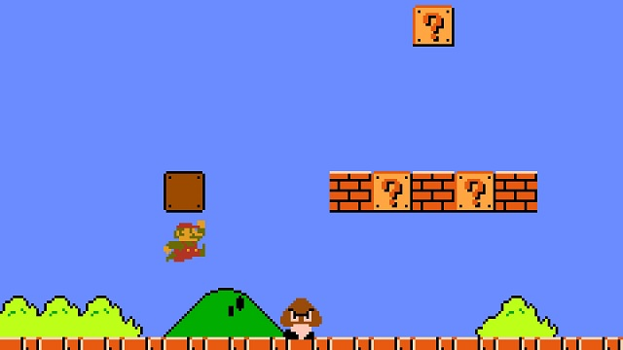

Slide 29
Recap
Definition of Game Design
Design terminology
Roles of a Designer
Application of game design

